Slide 1

Yelp business Reviews Sentiment Analysis for the Prediction of Star Ratings
Group G-9
Sanket Mhaiskar
Pratish Merchant
Akshay Kamath

Slide 2
Objectives
To identify ratings from reviews.
Identify the most positive and negative words in the set.
Perform sentiment analysis task to predict positive or negative emotions.

Slide 3
Data
Yelp data set review as a part of data set challenge.
Data set consists of the following data fields:
Business
Check in
Reviews
Tip
Users
For the scope of this project we mainly focus on user reviews and Business.
Roughly 25000 reviews are used to perform classification tasks.
Additionally, we have performed data pre-processing tasks as per our requirements.

Slide 5
Approach
Initial Approach: Classified reviews into positive and negative and applied classification techniques.
We have mainly used the following machine learning techniques.
Bernoulli's Naive Bayes.
Support Vector Machines.
For each classification technique, we have prepared a data set that maps a review to a sentiment – positive or negative. as follows: Sentiment | Review Text.
E.g. Positive | We were very pleased with the service!!

Slide 6
Sentiment Analysis Results Bernoulli Naïve Bayes
Accuracy | Majority Classifier
80.10% | 79%
 | Precision | Recall | F1-Score | Support
Negative | 0.50 | 0.43 | 0.46 | 1487
Positive | 0.86 | 0.89 | 0.88 | 6014
Avg. / Total | 0.79 | 0.80 | 0.80 | 7501

Slide 7
Sentiment Analysis Results SVM
Accuracy | Majority Classifier
90.79% | 79%
 | Precision | Recall | F1-Score | Support
Negative | 0.89 | 0.61 | 0.72 | 1487
Positive | 0.91 | 0.98 | 0.94 | 6014
Avg. / Total | 0.91 | 0.91 | 0.90 | 7501

Slide 8
Review Prediction
For Review Prediction, we have mainly used the following machine learning techniques, as before.
Bernoulli's Naive Bayes.
Support Vector Machines.
For each classification technique, we have prepared a data set that maps a review to a rating as follows: Review Star | Review Text.
E.g. 5 | We were very pleased with the service!!
We then classify each text into bag of words and provide input to the classification algorithms as Unigrams, Bigrams and Trigrams.

Slide 9
Review Prediction Result Naïve Bayes
Naïve Bayes: Unigrams + Bigrams.
Data Distribution: 80% Training, 20 % Test
Accuracy | Majority Classifier
43.93% | 32%
 | Precision | Recall | F1-Score | Support
1 | 0.55 | 0.32 | 0.40 | 706
2 | 0.28 | 0.13 | 0.17 | 781
3 | 0.34 | 0.17 | 0.22 | 1343
4 | 0.43 | 0.49 | 0.46 | 2465
5 | 0.47 | 0.70 | 0.56 | 2206
Avg. / Total | 0.42 | 0.44 | 0.41 | 7501

Slide 10
Review Prediction Result : SVM
Support Vector Machines: Unigrams + Bigrams.
Data Distribution: 80% Training, 20 % Test
Accuracy | Majority Classifier
56.86% | 32%
 | Precision | Recall | F1-Score | Support
1 | 0.75 | 0.66 | 0.70 | 250
2 | 0.50 | 0.27 | 0.35 | 249
3 | 0.53 | 0.35 | 0.42 | 469
4 | 0.49 | 0.69 | 0.57 | 786
5 | 0.67 | 0.65 | 0.66 | 747
Avg. / Total | 0.58 | 0.57 | 0.56 | 2501

Slide 11
N-gram Result Summary
 | Bernoulli NB Accuracy Score | SVM Accuracy Score
Unigram | 42.61% | 55.31%
Bigram | 41.35% | 53.57%
Trigram | 33.73 % | 41.75%
Unigram + Bigram | 43.93% | 56.85%
As we can see, we have considered our baseline to be the majority classifier, which comes to 32%
All classification techniques have performed better than our baseline.
Using a combination of unigram + bigram has performed better than just unigrams, bigrams or trigrams.

Slide 13
Most Positive and Negative Words
Used a Dictionary of word – score using Senti-Word list. Scores are between +1 and -1.
Distribute review into sentences and tokenize into words.Rank words using above dictionary.
Additionally we can rank entire sentence .
Output is word , frequency and score.
Created a word cloud of output using Kumo library.

Slide 14
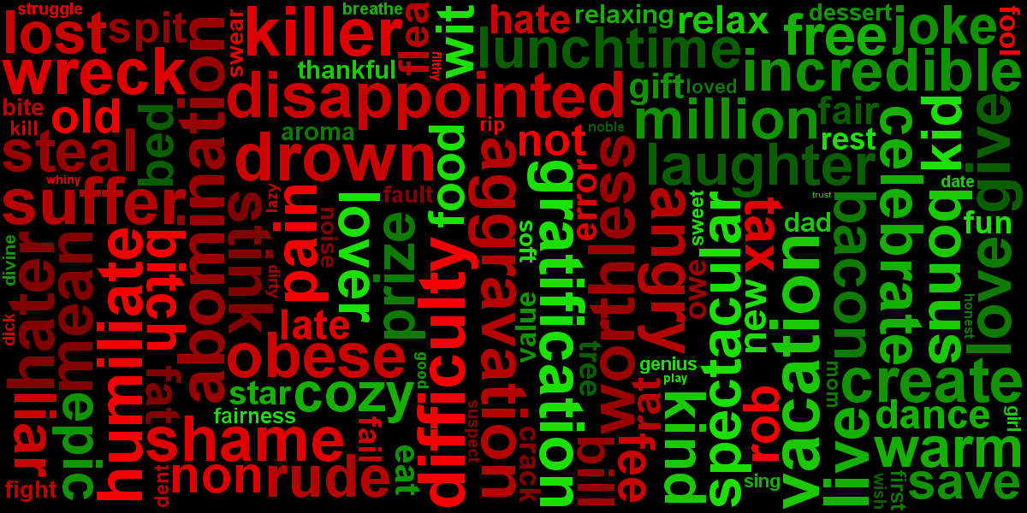

Slide 15
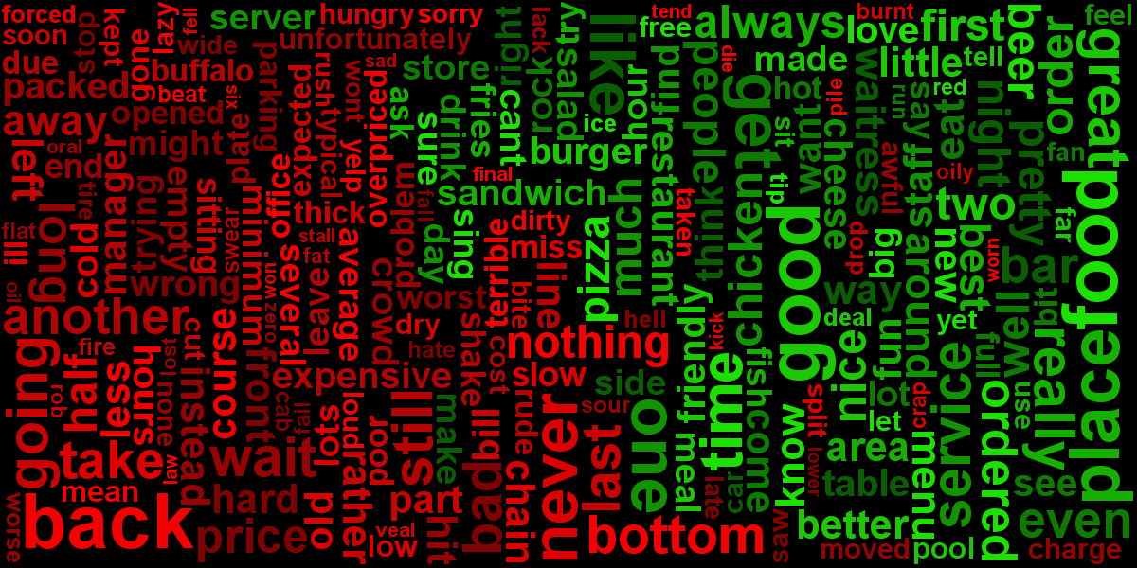

Slide 16
TOOLS
Scikit- Learn
Natural Language Toolkit
Senti Word Net
Kumo Word Cloud

Slide 17
Conclusions
We Performed sentiment analysis to classify positive and negative words and got a 10% improvement over baseline using SVM.
SVM performs better than Naïve Bayes.
Combination of bi-grams and unigrams gives best results.
The accuracy is affected with the increase in the number of categories.
The accuracy increases with increase in data.

Slide 18
Questions ?????????

Slide 19


